Slide 1
Telecom Churn
Group 4: Archana, Feliciana, Iman, Jiby, Julio, Sai Sarath, Wang

Slide 2
Background
Objective: Identify factors influencing customer churn and build a model to predict future customer churn.
A telecom company has data relating to it’s customers where they want to predict whether the customer will churn based on their services.
Based on the variables related to Customer behavior such as Gender, tenure, Phone service, Multiple lines, etc.

Slide 3
Data Pre-processing
Understanding the data is very important when performing this analysis.
Examine each variable’s distribution and trend related to the churn.
We ignore values such as customer-id as it’s a unique id which doesn’t have any significance over churn.
We also performed outlier analysis and checked for outliers in each of the variables but to no effect.

Slide 4
Cleaning and Validation
While investigating through the data, we found some missing values in the total charges column.
We excluded the 11 rows because there were ample analogous data combinations where customer is not churning out.
For training and validation, we took the ratio as 70:30

Slide 5
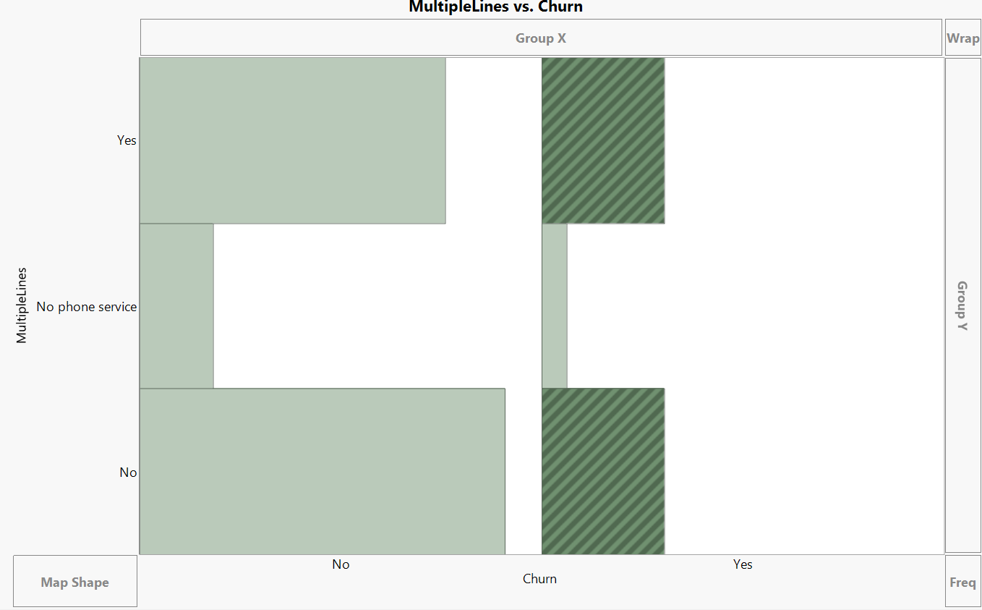
Trend of Multiple Lines with Churn

Slide 6
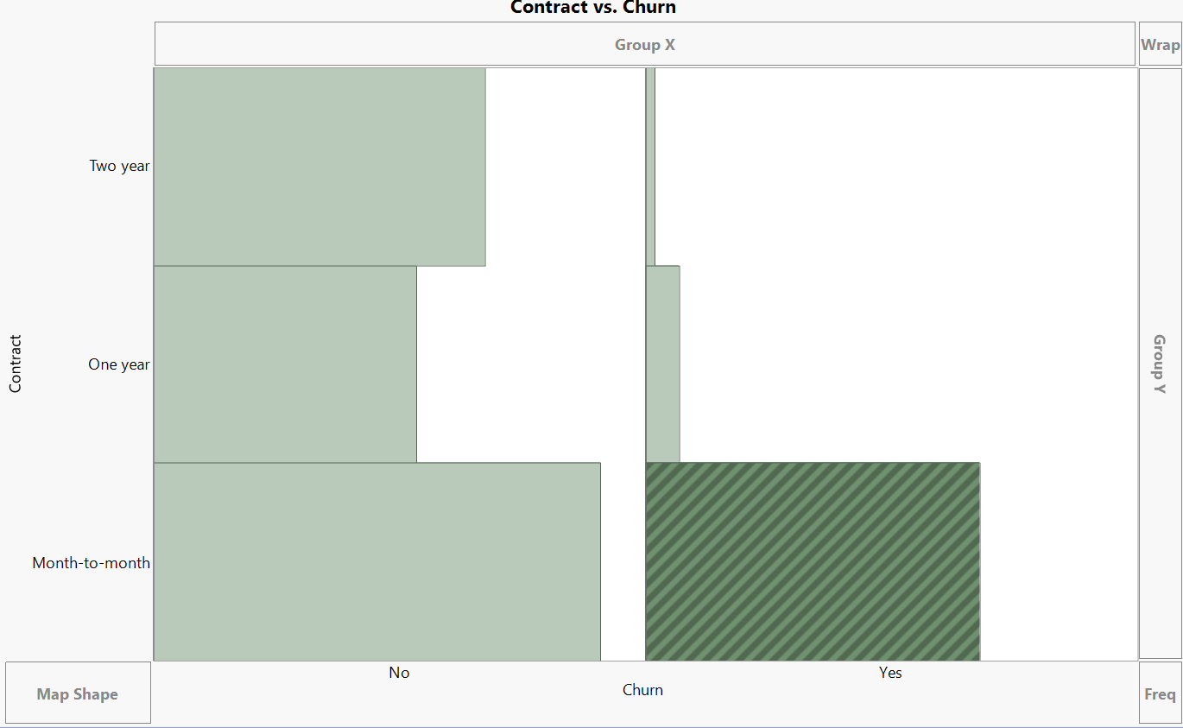
Trends of Contract with Churn

Slide 7
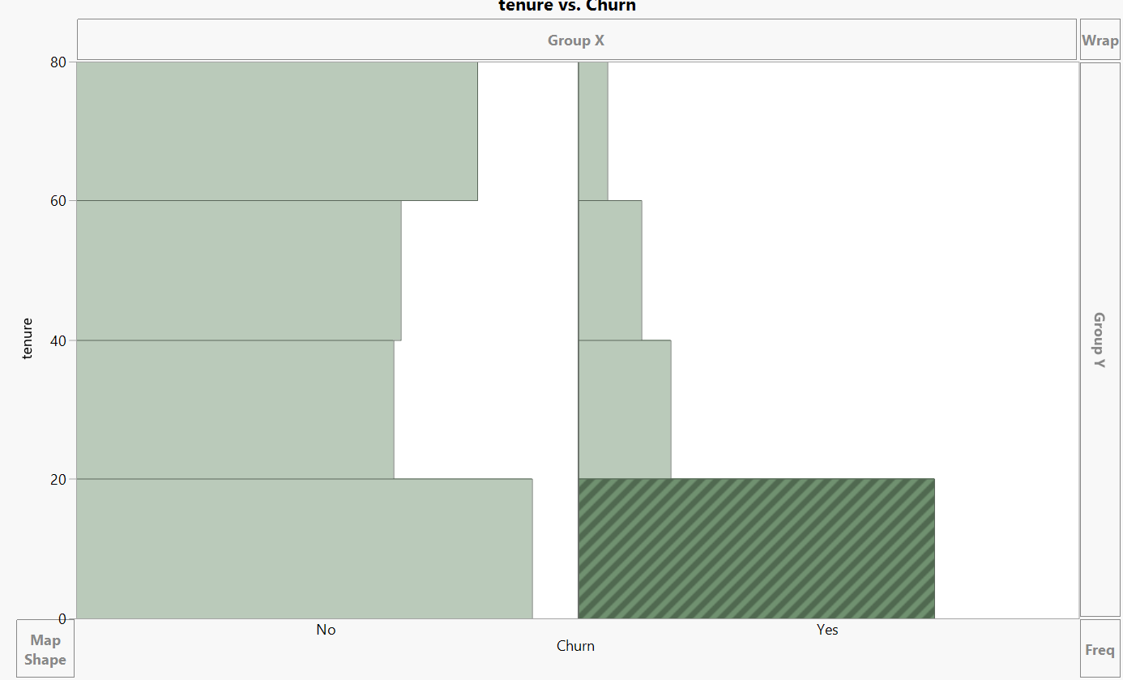
Trends of Tenure with Churn

Slide 8
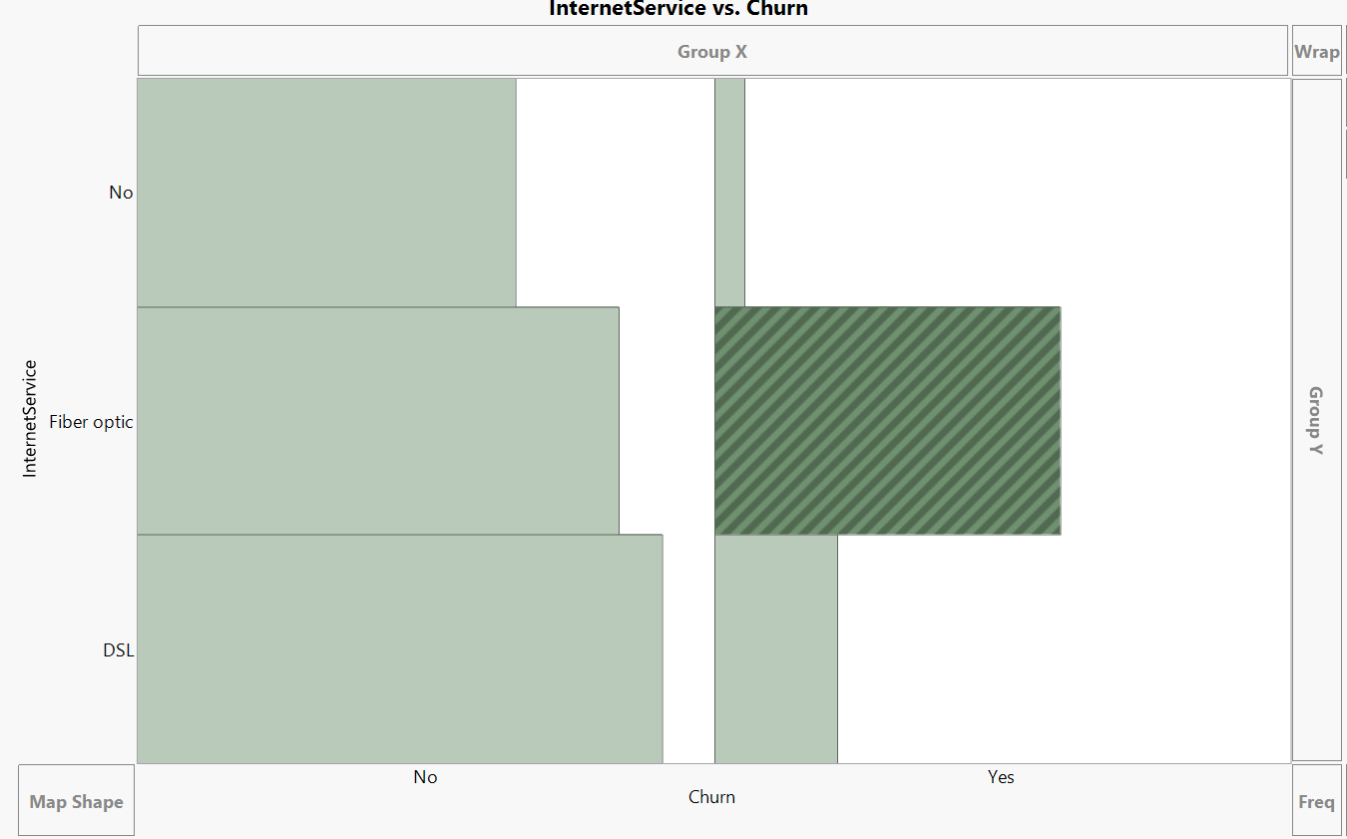
Trends of Internet Service with Churn

Slide 9
Data cleaning - 1
Excluded 214 rows where contract is Long-term and Churn is “Yes”. These 214 rows are about 6% among the Long-term churn data.
We are ignoring this 6% because there is no correlation with any other variable that may be causing this churning and the churning looks purely random and misguiding to the model.
We also observed that the predicted value for these records were false. So eliminating those from training the model seemed justified and more effective

Slide 10
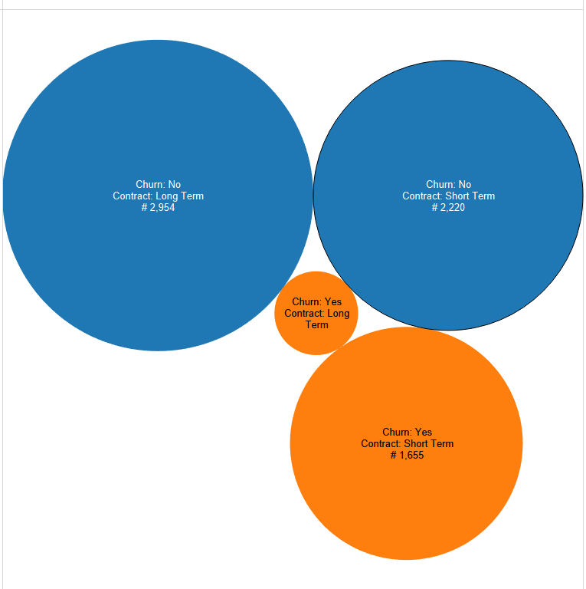
We are ignoring this part.

Slide 11
Data cleaning - 2
Excluded 160 rows when Tenure is <=6, Churn is “No” and Internet Service is Fiber Optic.
The common behavior of low tenured customers when they use expensive Fiber Optic Internet connection is high churn turn out.
Thus we are removing these rational outliers by assuming that these non-churning entries will not impact the model goal.

Slide 12
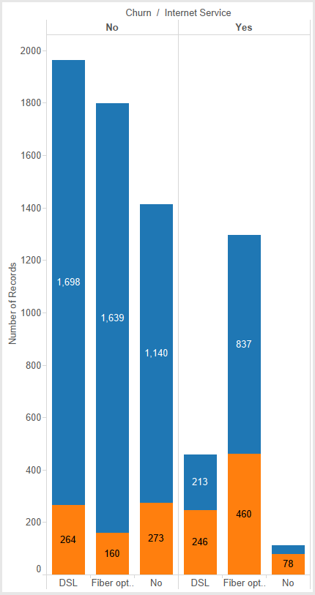

Slide 13
Analysis
After determining the trends of the data, we ended up finding the variables which most impact our data
Those variables include :
Internet Service
Multiple lines
Contract
Tenure

Slide 14
Building a Model
Different approaches:
Logistic Regression
Decision Trees
Neural Network
We ran 19 different models, each time with a different set of variables to find the best match.
Reasoning: The goal is to predict categorical response of customers in the binary form of “Yes” or “No”

Slide 15
Model Comparison
Table A (Model Experiments and Observations)
Ver. | Model | Variables | R^2 Train | R^2 Valid. | Misc. % | MR Type1 | MR Type2 | ROC | Comments
1 | Decision tree | 12(G,SC,P,D,PS,ML,IS,TS,C,PB,PM,TC) | 27.00% | 24.70% | 20.30% | 15.60% | 36.70% | 83.50% | Number of splits -12
2 | Logistic | 12(G,SC,P,D,PS,ML,IS,TS,C,PB,PM,TC) | 25.60% | 26.02% | 20.26% | 16.18% | 35.45% | 83.30%
3 | Neural | 12(G,SC,P,D,PS,ML,IS,TS,C,PB,PM,TC) | 27.20% | 26.90% | 19.90% | 16.60% | 33.57% | 84.10% | TanH(3,0)
4 | Decision tree | 7(G,SC,PS,IS,TS,C,TC) | 28.80% | 26.70% | 19.90% | 16.06% | 34.47% | 84.50% | Number of splits -36
5 | Logistic | 7(G,SC,PS,IS,TS,C,TC) | 24.10% | 25.40% | 21.40% | 16.95% | 38.33% | 82.20%
6 | Neural | 7(G,SC,PS,IS,TS,C,TC) | 25.10% | 26.50% | 21.06% | 17.25% | 36.51% | 83.05% | TanH(3,0)
7 | Logistic | 5(T,C,IS,TC,D) | 25.62% | 25.53% | 21.13% | 17.37% | 36.54% | 83.41%
8 | Neural | 5(T,C,IS,TC,D) | 26.75% | 26.73% | 20.88% | 16.28% | 37.36% | 83.79% | TanH(3,0)
9 | Decision tree | 5(T,C,IS,TC,D) | 26.50% | 26.50% | 21.05% | 16.88% | 37.03% | 83.33% | Number of splits -12
10 | Logistic | 4(T,C,IS,G) | 25.01% | 25.69% | 21.45% | 17.40% | 37.63% | 83.13%
11 | Neural | 4(T,C,IS,G) | 26.01% | 26.42% | 21.53% | 17.94% | 37.04% | 83.45% | TanH(3,0)
12 | Decision tree | 4(T,C,IS,G) | 26.55% | 26.47% | 21.05% | 16.88% | 37.03% | 83.33% | Number of splits -12
13 | Decision tree | 5(T,C,IS,ML,TC) | 27.69% | 26.71% | 20.89% | 12.67% | 40.61% | 84.05% | Number of splits -16
14 | Logistic | 4(T,C,IS,ML) | 25.72% | 25.87% | 20.82% | 16.46% | 36.92% | 83.42%
15 | Neural | 4(T,C,IS,ML) | 27.44% | 26.87% | 20.49% | 16.65% | 35.52% | 84.23% | TanH(3,0)
16 | Decision tree | 4(T,C,IS,ML) | 27.69% | 26.71% | 20.89% | 12.67% | 40.61% | 84.05% | Number of splits -16
17 | Decision tree | 4(T,C,IS,ML) | 40.46% | 40.40% | 18.45% | 8.81% | 40.61% | 88.97% | Excluding Exception 1
18 | Decision tree | 4(T,C,IS,ML) | 35.57% | 33.76% | 18.61% | 13.67% | 33.25% | 86.56% | Excluding Exception 2
19 | Decision tree | 4(T,C,IS,ML) | 48.89% | 48.26% | 16.04% | 9.98% | 33.25% | 91.51% | Excluding both exceptions
Abbreviations: Gender: G, SeniorCitizen: SC, Partner: P, Dependents: D, Tenure: T, PhoneService: PS, MultipleLines: ML, InternetService: IS, OnlineSecurity: OS, OnlineBackup: OB, DeviceProtection: DP, TechSupport: TS, StreamingTV: STV, StreamingMovies: SM, Contract: Co, PaperlessBilling: PB, PaymentMethod: PM, MonthlyCharges: MC, TotalCharges: TC

Slide 16
Our Winning Model
We choose decision tree because it is easy to explain.
The best R^2 value and the best Misclassification rate.
Less variables and relatively simple to interpret.
Top few nodes can show most important variables in the model.

Slide 17
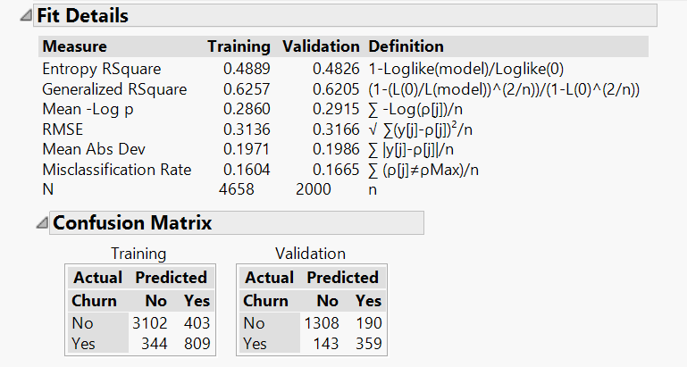
Model Interpretation

Slide 18
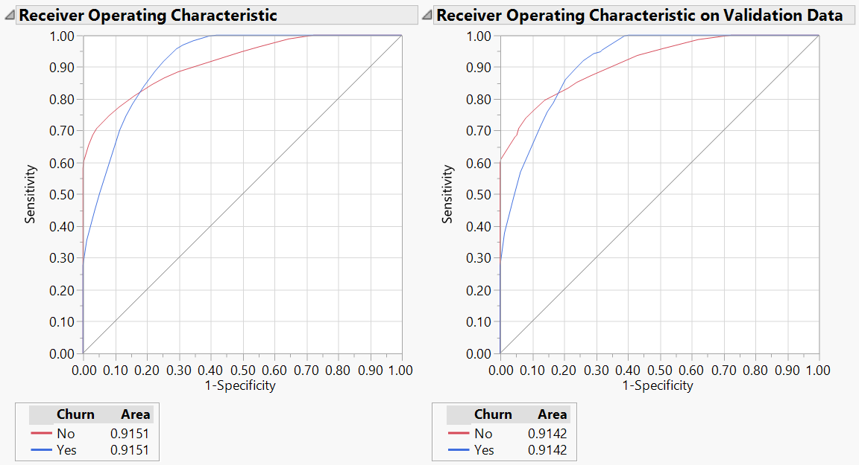
ROC - Curve

Slide 19
Conclusion
The prediction model and data analysis shows below trends of customer churning:
More than 90% of the long term customers tend to stay with the company
86% of low tenure customers using fiber optics tend to leave the company
People using no internet services stay with the company majority of the time

Slide 20
Improving the model
We got the misclassification rate down from 20% to 16%.
If we had the following information, we could improve our model:
Age
Income of the customers
Plan used by the customers

Slide 21
Recommendations
Focus on low tenure customers.
Identify the challenges for the customers using internet services.
Strategize plans for Fiber Optics users.
Improve the services of customers with short term contracts.

Slide 22
Thank You!

